Slide 1
Fisher and Tea

Slide 2
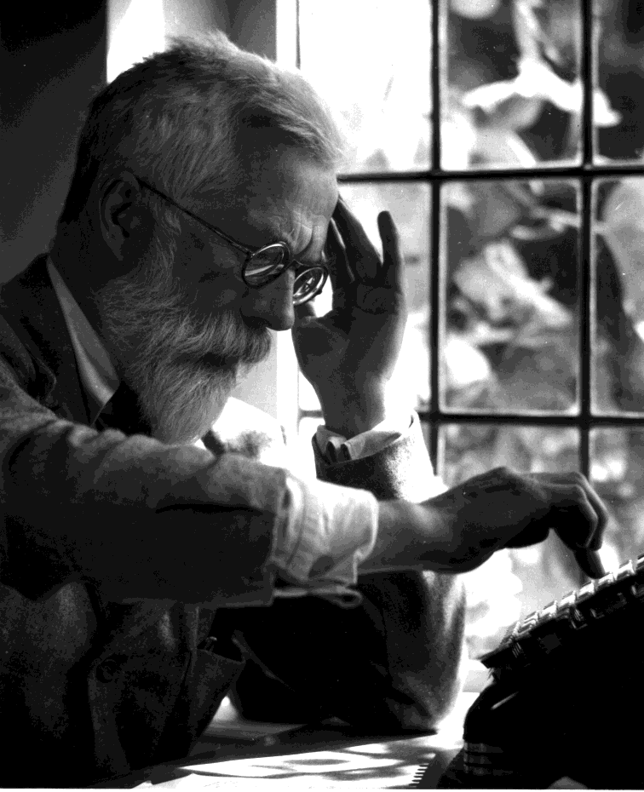
R. A. Fisher
A experiment by R. A. Fisher (famous early statistician, 1890-1962)
A lady at a tea party claims that she can tell the difference between putting the milk in first and second.
How can we be sure?

Slide 3

The lady tasting tea
Fisher set up an experiment
The lady (Muriel Bristol) was presented with 8 cups of tea
4 had tea with milk added second
4 had milk with tea added second
She was asked to select the 4 cups prepared by putting the milk in first and second.
First, how many “draws” can Muriel take of the 8 cups?

Slide 4
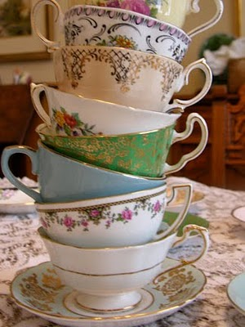
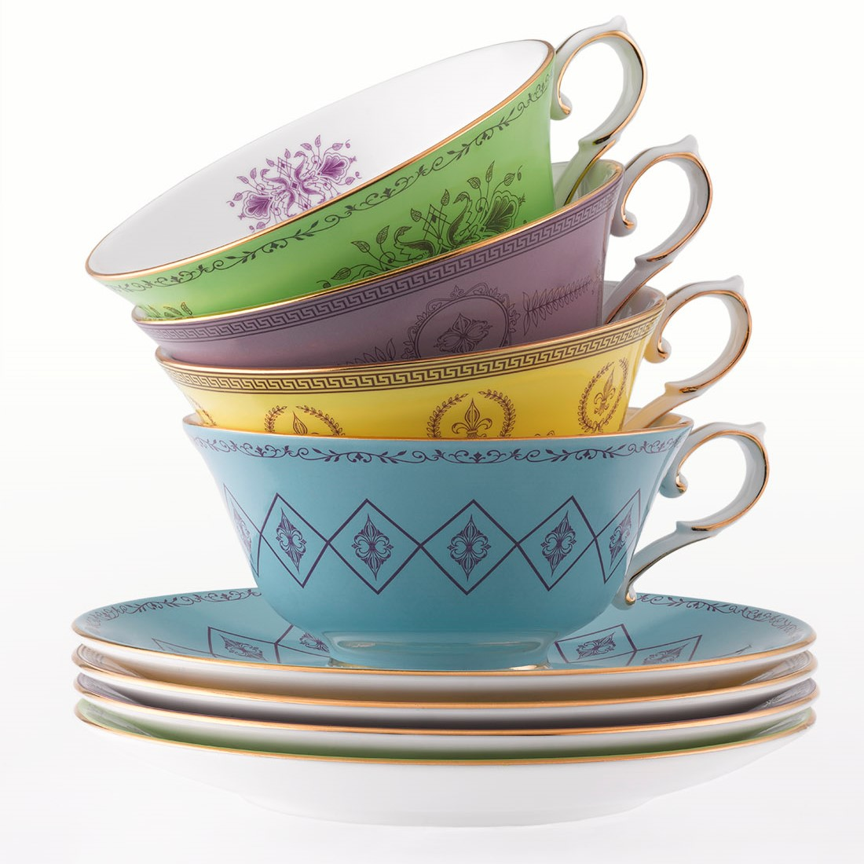
How many ways can Muriel choose?
8
4

Slide 5
What is the sample space?
Right | Wrong | # | %
4 | 0 |  | 1
3 | 1 |  | 23
2 | 2 |  | 51
1 | 3 |  | 23
0 | 4 |  | 1
Total |  |  | 100

Slide 6
Hypergeometric distribution (discrete)
Arguments
x, q vector of quantiles representing the number of white balls drawn without replacement from an urn which contains both black and white balls.
m the number of white balls in the urn. [cups with milk → tea]
n the number of black balls in the urn. [cups with tea → milk]
k the number of balls drawn from the urn. [number of “draws”]
p probability, it must be between 0 and 1.
nn number of observations. If length(nn) > 1, the length
is taken to be the number required.

Slide 7
The lady tasting tea
As the story goes, the lady identified all 4 cups correctly. What were the chances (exactly!)?
> dhyper(4, 4, 4, 4) # dhyper(x, m, n, k)
[1] 0.01428571
> 1 - phyper(3, 4, 4, 4) # phyper(q, m, n, k)
[1] 0.01428571

Slide 8
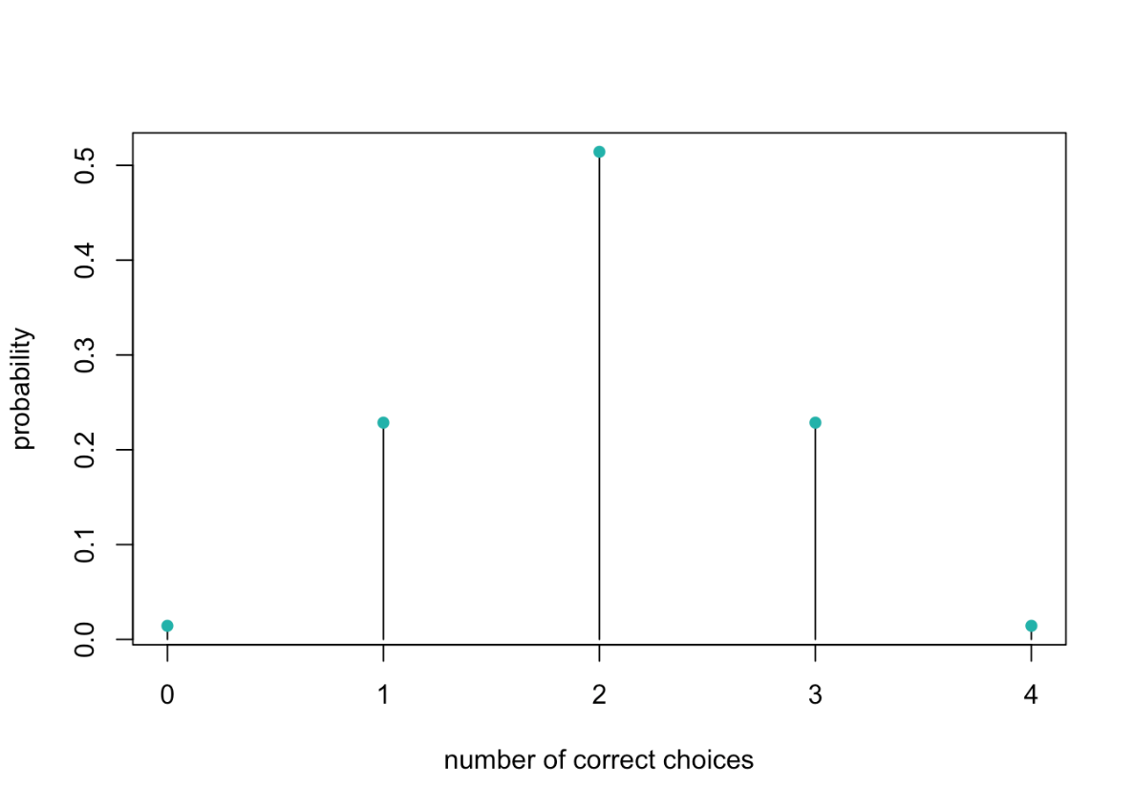
The lady tasting tea
As the story goes, the lady identified all 4 cups correctly. What were the chances (exactly!)?
> dhyper(4, 4, 4, 4)
[1] 0.01428571
> 1 - phyper(3, 4, 4, 4)
[1] 0.01428571

Slide 9
The lady tasting tea
The expected value of a hypergeometric variable is known to be:
k <- 4 # number of cups picked
m <- 4 # number of true “hits”
N <- 8 # total number of cups
k * (m/N) # population mean
[1] 2
What if we wanted to know whether Muriel was better than “average”, with 𝝰 = .05?

Slide 10
What if we wanted to know whether Muriel was better than “average”, with 𝝰 = .05?
What is the null hypothesis?
What is the alternative hypothesis?
What if we ramp up to 100 cups of tea?
What will accept as evidence of better than average?

Slide 11
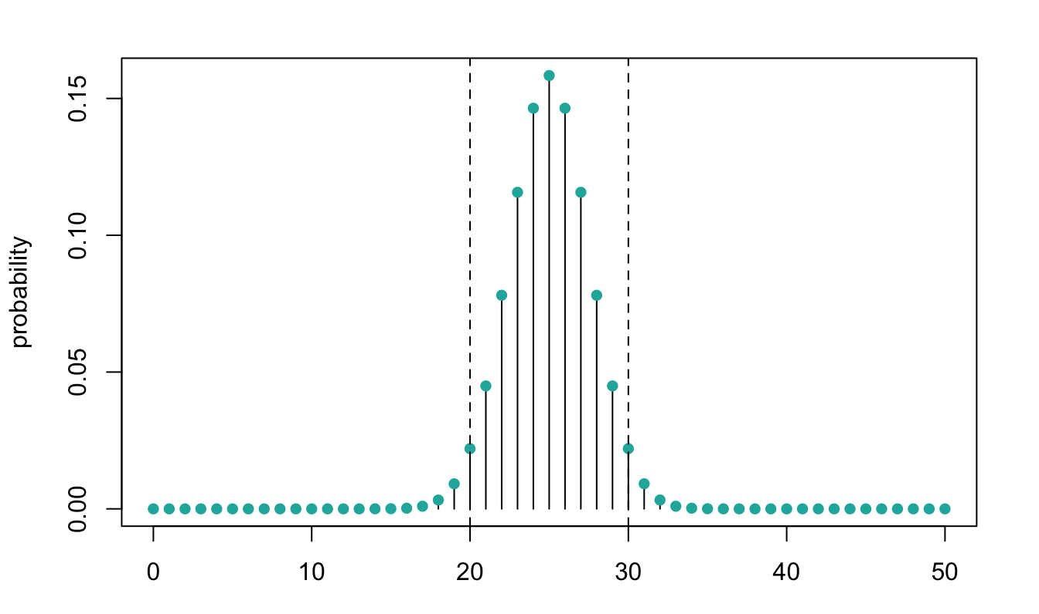
95% confidence interval for known µ with 100 cups
qhyper(.975, 50, 50, 50) # upper tail p = .025
[1] 30
qhyper(.025, 50, 50, 50) # lower tail p = .025
[1] 20
p = .025←
→ p = .025

Slide 12
What if Muriel got exactly 31 correct?
dhyper(31, 50, 50, 50)
[1] 0.009163535
p = .025←
→ p = .025

